Slide 1
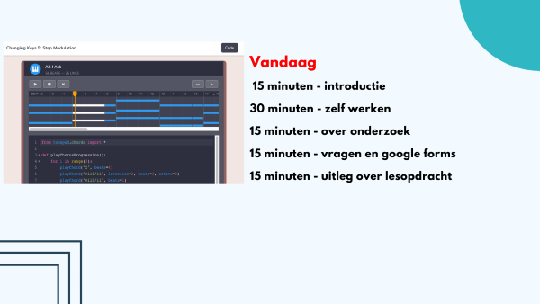
Presentatie i&i conferentie 2022
Python leren met muziek
Krijn Hoogendorp

Slide 2

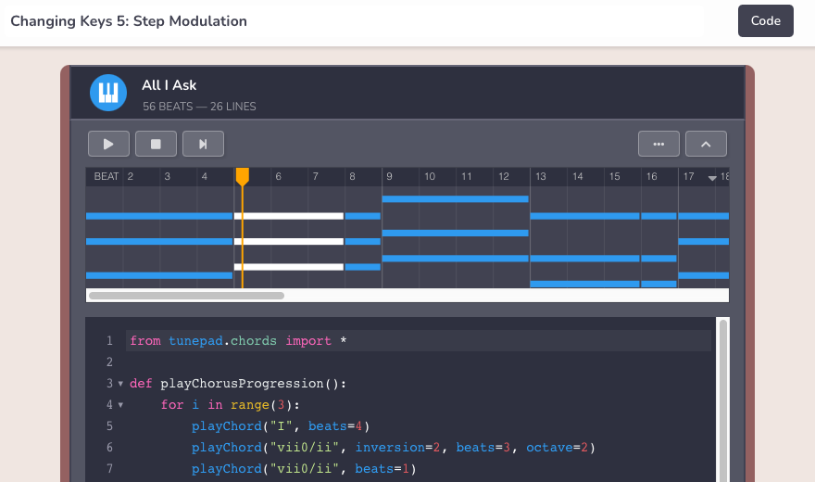

Vandaag
15 minuten - introductie
30 minuten - zelf werken
15 minuten - over onderzoek
15 minuten - vragen en google forms
15 minuten - uitleg over lesopdracht

Slide 3
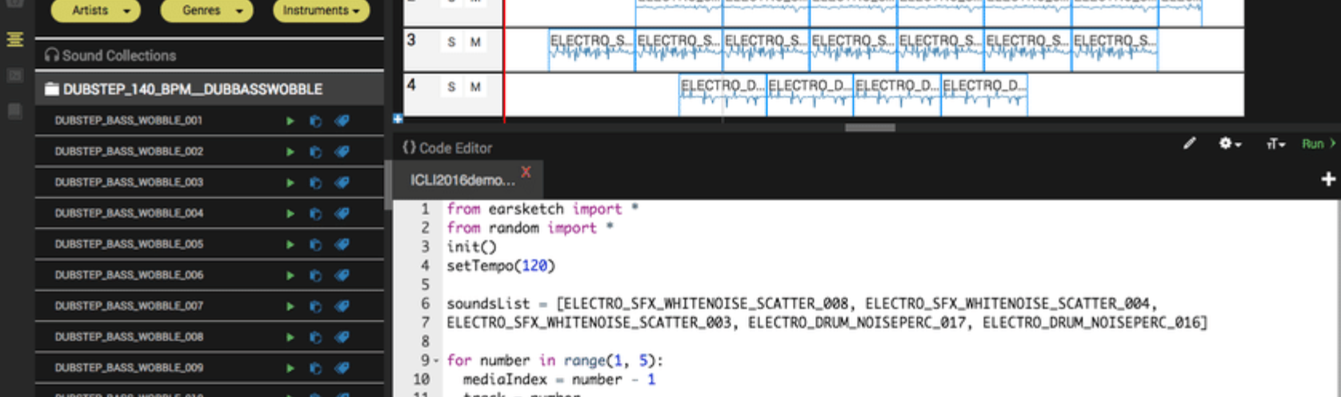

Informaticadocent sinds 2016 (middelbare school vmbo/havo/vwo), mbo en hbo.
Hiervoor oa before specialist en project manager ABN AMRO/IBM.
Momenteel werkzaam bij Hogeschool van Amsterdam (Cyber Security) en 1 dag p/w bij ROC van Amsterdam (opleiding Drones & Engineering)
Krijn Hoogendorp
k.hoogendorp@hva.nl

Slide 4
Is het mogelijk om programmeren te leren met muziek als context?

Slide 5
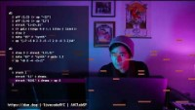
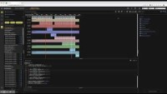
Is het mogelijk om programmeren te leren met muziek als context.
Ja:
Sonic Pi (Ruby)
EarSketch (Python/JavaScript)
TunePad (Python)

Slide 6
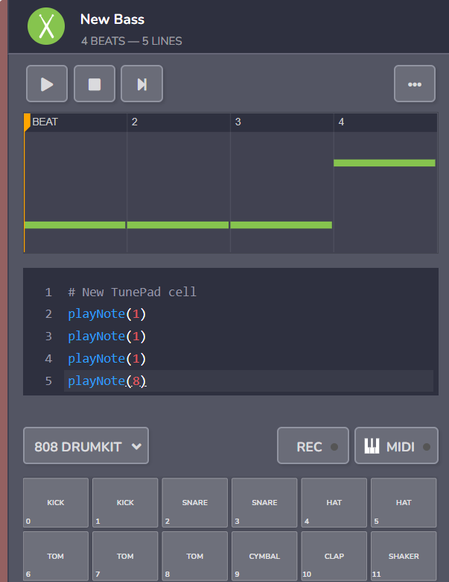
playNote(1) laat een geluid horen
In dit geval een ‘kick’
Is dat heel anders dan het printen van een string?
print(“hallo”)

Slide 7
playNote(1) laat een geluid horen
In dit geval een ‘kick’
Is dat heel anders dan het printen van een string?
print(“hallo”)
Voorbeeld:
https://tunepad.com/project/37117

Slide 8
Heel veel constructies die in programmeren gangbaar zijn, kun je ook met muziek uitleggen.

Slide 9
Heel veel constructies die in programmeren gangbaar zijn, kun je ook met muziek uitleggen.
List:
Een C schaal = [60, 62, 64, 65, 67, 69, 71, 72]

Slide 10
Heel veel constructies die in programmeren gangbaar zijn, kun je ook met muziek uitleggen.
Een list met een for-loop
C_schaal = [60, 62, 64, 65, 67, 69, 71, 72]
For i in C_schaal:
playNote(i)
Niet alleen lists en variabelen, maar ook functies
Voorbeeld van student: New Jam Session (tunepad.com)

Slide 11
Maar waarom muziek als context gebruiken?
Time on task
Low floor/high ceiling/wide walls
Geschikt voor verschillende leeftijden/niveau’s

Slide 12
Maar waarom muziek als context gebruiken?
Time on task
Low floor/high ceiling/wide walls
Geschikt voor verschillende leeftijden/niveau’s
MAAR: ook nadelen(?)

Slide 13
Probleem met populatie van Informatica
Meer mannen dan vrouwen
‘Ethnically skewed’ (GeorgiaTech onderzoeken)
‘computer science meer geschikt voor ‘beta’ ’ leerlingen.
Informatie is vaak alleen mogelijk voor NT en NG profielen.

Slide 14
Waarom is populatie niet divers?
Misschien vanwege imago en geschiedenis van van het vakgebied.
Veel opdrachten zijn gerelateerd aan wiskundige problemen zoals
‘kortste pad’ of ‘toren van Hanoi’.
Uitdagend voor sommigen
Niet uitdagend voor velen.
n

Slide 15
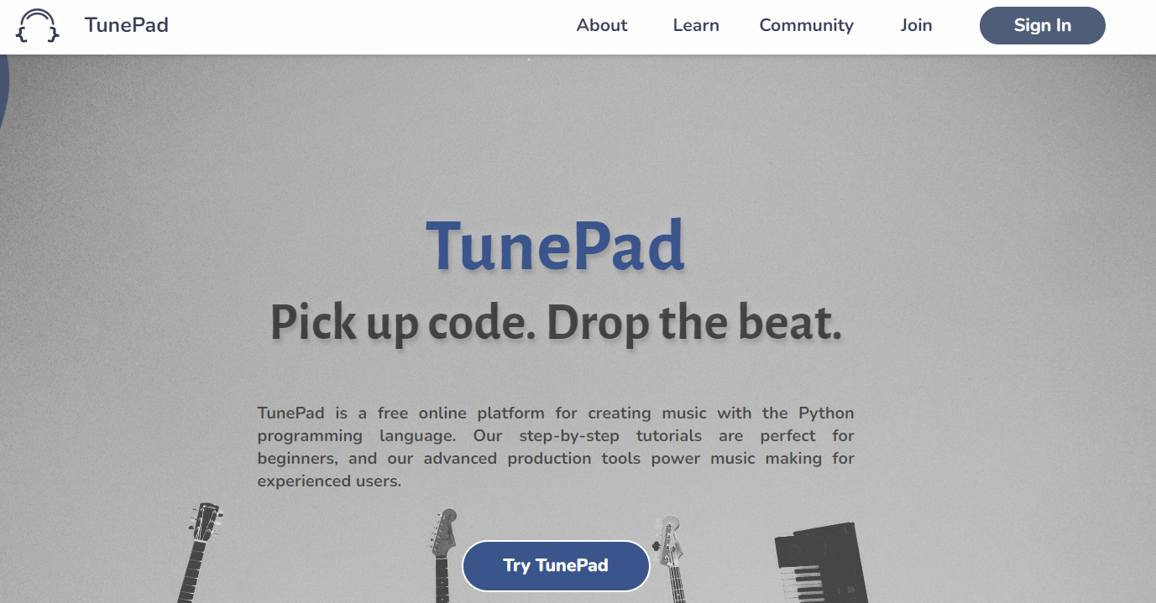
Zelf aan de slag
https://tunepad.com/

Slide 16
Research
The effectiveness and attractiveness of music as a context to learn to code

Slide 17
Importance of programming
Computer knowledge is form of literacy, when societies become dependent on that knowledge, those who can code have power and influence on those who cannot. (based on Horn et al., 2020)
What are schools for?
“... powerful disciplinary knowledge .”
“…what the knowledge can do or what intellectual power it gives to those who have access to it.”
(Michael Young, 2008)
B

Slide 18
Importance of diverse student population
But in professional field:
not so much math/statics,
also design,
and programming is currently present in most domains (‘omnipresent’)
Development of e.g. arts as a context to teach coding

Slide 19

But is context arts,
attractive enough to diversify the student population?,
‘computational’ enough?, and
will concepts learned be transferable to other contexts?

Slide 20
Is the context music suitable for teaching coding.
Will it produce sufficient content-knowledge on coding?
are this skills and knowledge transferable from one domain (music) to other domains?
What aspects music can ensure a permanent and flexible knowledge of coding concepts?
The research will be about the effectiveness and attractiveness of music as a context to learn how to code.

Slide 21
Themes to be researched:
Is music an appropriate context for teaching specific programming concepts and aptitude (and are there certain characteristics in music that hamper learning how to code).
How will the characteristics and complexity of music influence the process of learning.
What are requirements to come to efficient transfer of knowledge between different programming domains.
What are the aspects of music that can promote computational thinking.

Slide 22
Is music an appropriate context
What characteristics in music that hamper or help learning how to code.
An efficient context should (Nijenhuis-Voogt et all, 2020):
be meaningfull,
in line with student interests
usefull for learning objectives.

Slide 23
Is music a meaningful context
Meaningful can have characteristics:
part of daily experience,
should make sense,
students can be actively involved.

Slide 24
Is music in line with student interests.
Yes, but ……

Slide 25
Is useful for learning objectives
According to Bell and Bell (2018) “…there are related forms of thinking…”

Slide 26
b. Characteristics and complexity of music as a context
The complexity of a context is of importance as the time needed for understanding the context can not be used for the actual learning objectives (Guzdial, 2010).
Cognitive load: intrinsic (complexity of information) extraneous (complexity of instruction) en germane (learner characteristics) (in Nijenhuis, 2020).
What is the effect on learning, when students do not only get information on the programming concepts but also need to learn the basics of music.
Part of this question is the role of the teachers. Can they work with such a context. What are the bounderies.

Slide 27
b. Characteristics and complexity of music as a context
The complexity of a context is of importance as the time needed for understanding the context can not be used for the actual learning objectives (Guzdial, 2010).
Cognitive load: intrinsic (complexity of information) extraneous (complexity of instruction) en germane (learner characteristics) (in Nijenhuis, 2020).
What is the effect on learning, when students do not only get information on the programming concepts but also need to learn the basics of music.
Part of this question is the role of the teachers. Can they work with such a context. What are the bounderies.
“EarSketch learners are able to compose music and learn how to program
without the added barrier of entry of learning music theory about harmony, melody, chord progressions” (Magerko et al., 2016).

Slide 28
c. Requirements of efficient transfer of knowledge.
Transfer of knowledge between domains will not happen naturally.
Organized and coherent understanding of the material is needed
In instructions explicit attention to the underlying structure of knowledge
attention for the use in other domains.
(Bransford et all, 2020)
How can effective transfer of knowledge and skills happen from a music context to other contexts.
Transfer of knowledge and skills is likely to happen when:
through extensive exercise (the low road),
Making transfer explicit through abstraction of concepts and combine with other contexts (the high road).

Slide 29
d. Relationship to Computational Thinking
Computational thinking (CT) is a set of problem-solving methods related tied to the field of Computer Science (Wing, 2006)
Characteristics: decomposition, pattern recognition, data representation, generalization/abstraction, and algorithms.
Bell & Bell (2018): There are common elements between music and CT.:
notations in formal languages (music notation compared to programming languages and protocols);
sequence (the order in which notes appear in time; and the order of notes and order of statements in a computer program)
repetition (in music this includes repeats and computing loops)

Slide 30
Results
Results about the requirements for effective transfer of knowledge between contexts.
Results about the cognitive processes involved in learning how to code.
Research based arguments for the diversification of contexts in computer science → suggesting new opportunities for learning
Secondary result: increase attractiveness of programming

Slide 31
Methods
a design study, a series of lessons will be developed in which programming concepts are taught with the use of TunePad development environments.
Partly of interpretivist nature, through discussions with teachers and students about the effects of learning to code through music, but also through observing students and teachers while they are working with the material.
Partly empirical: artefacts created in the lesson series will be analyzed
Needed: a variety of secondary schools willing to experiment with the material
The results will be analyzed and compared with existing literature on learning how to code and the cognitive processes related to learning how to code and computational thinking.

Slide 32
Other options?
Will students also use their coding skills and knowledge in other contexts (other subjects). What is needed to make such transfer a success ?

Slide 33
Other options?
Will students also use their coding skills and knowledge in other contexts (e.g. other subjects). What is needed to make such transfer a success ?
QUESTIONS/REMARKS?

Slide 34
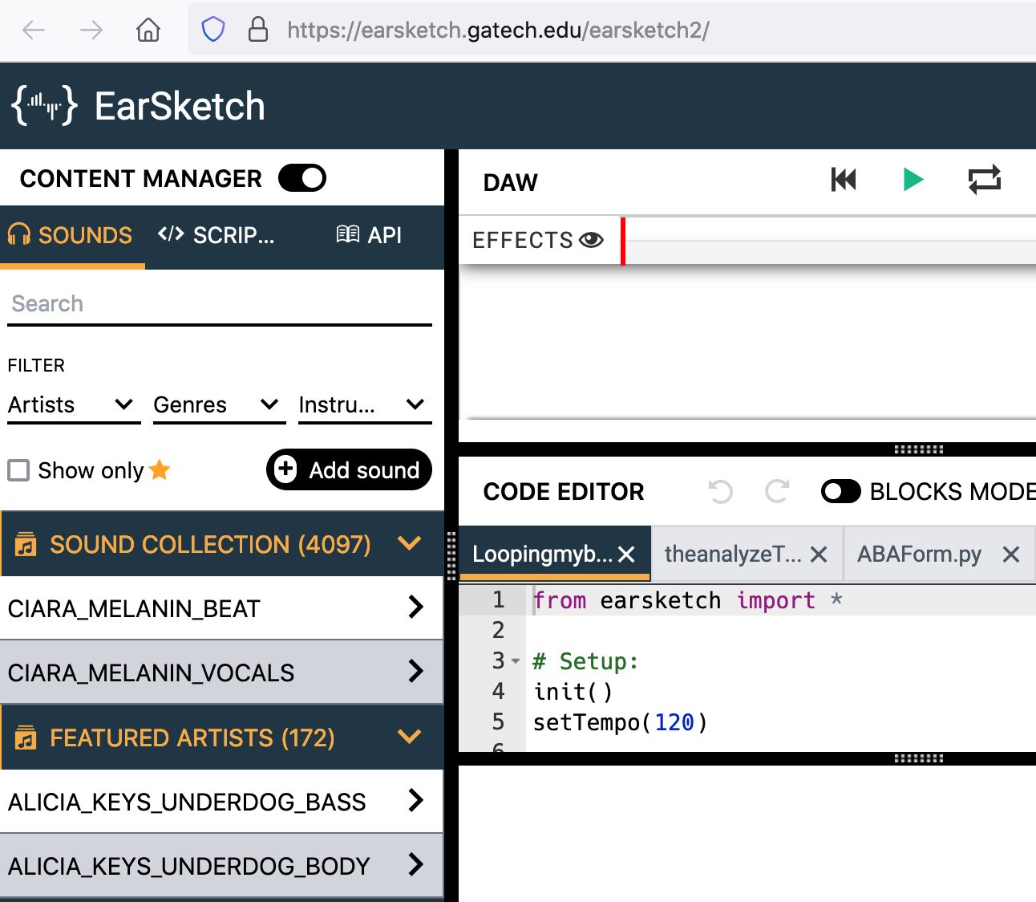
Programmeren van muziek
Context
Transfer
Algorithmic thinking

Slide 35
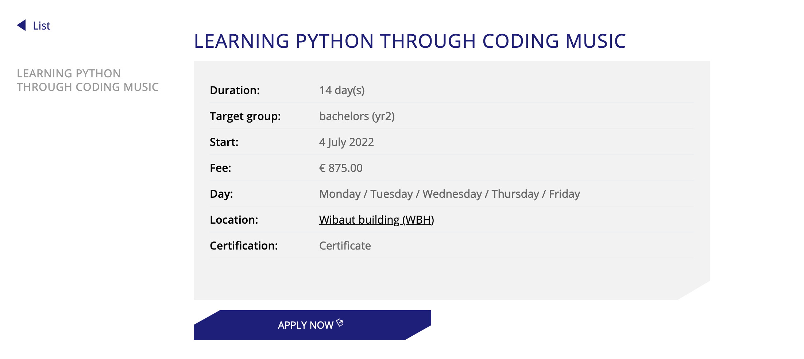

Literature used: Introduction to Digital Music with Python Programming (2022, Horn, West & Roberts)

Slide 36
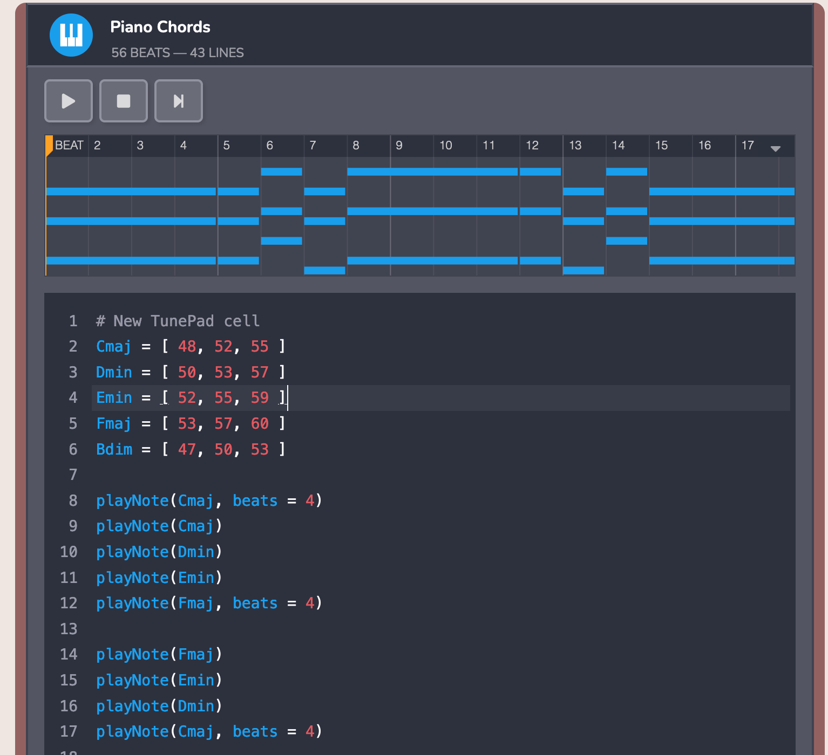
Tunepad
Beats:
https://tunepad.com/featured/5
Chords/lists:
https://tunepad.com/project/29648
Melody/lists
https://tunepad.com/project/29648

Slide 37
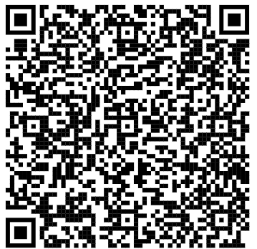
Invullen google forms indien meer info gewenst (en voor inleveren product).
https://forms.gle/SN3Tizkv9EBrFkpq6

Slide 38
Opdracht
Maak een eigen uitvoering 12 maten van 4 beats
Schaal is [55,57,58,60,61,63,65] → G, A, Bb, C, Db, Eb, F
Maak drum met nadruk op beat 2 en 3
Maak basslijn met gebruik van de genoemde noten
Maak melody met gebruik van de genoemde noten
Het moeten 12 maten zijn van 4 beats (loops zijn mogelijk)
Voorbeeld
https://tunepad.com/project/37528
https://tunepad.com/project/37531

Slide 39
Opdracht Swing
1930s, uptempo, 4 kwartsmaat met nadruk op maat 2 en 4.
Over swing: https://youtu.be/bGiPJZ-wRb4
Wynton Marsalis: https://youtu.be/_mLvytV2GrA
Zuco103 video: https://youtu.be/jmoNxcygEdE
Resultaten
https://tunepad.com/project/37528
https://tunepad.com/project/37531

